Slide 1
TCPDump Lab
Contributions by Neil Plotnick, Everett High School (Everett, MA)

Slide 2
TCPDump Lab
Materials needed
Kali Linux Virtual Machine
Software Tools used (From Kali Linux OS)
tcpdump (TCP/IP Packet Analyzer)

Slide 3
Objectives Covered
Security+ Objectives (SY0-601)
Objective 4.1 – Given a scenario, use the appropriate tool to assess organizational security
Packet capture and replay
Tcpdump

Slide 4
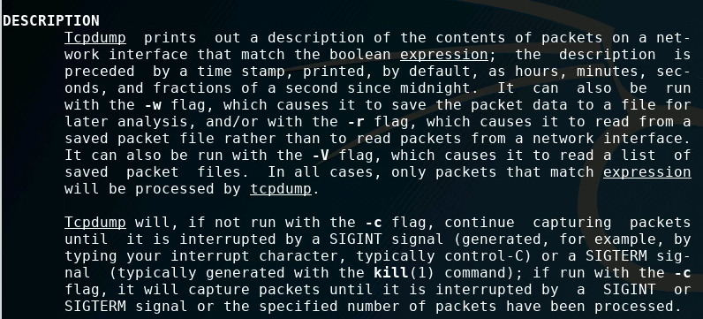
What is TCPDump?
Data-network packet analyzer program that runs inside the Terminal
Prints contents of network packets
Prints on screen or saved as text file
Notes:
Bank: Chase
Username: jsmith17 Password: @pp13s33d

Slide 5
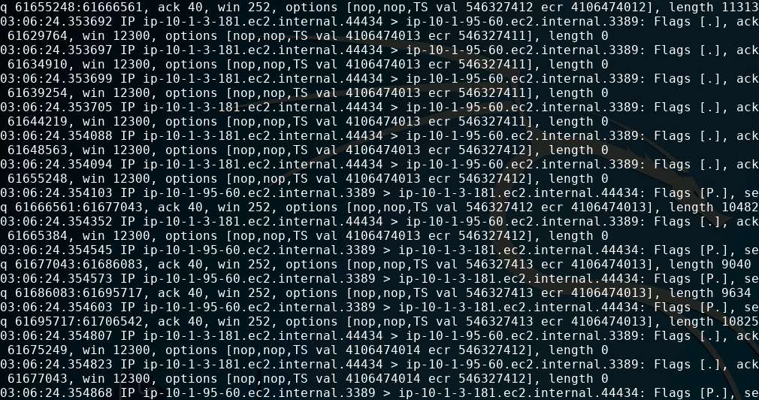
The tcpdump Lab
Set up the VM environment
Find your network interface
Capture packets
Contents of a Packet
Reduce packets dropped
Clean-up the output
Contents of a “Quiet” Packet
Expand output
Capture as a .txt file

Slide 6
Setup Environment
Log into your range
Open the Kali Linux Environment
You should be on your Kali Linux Desktop
Open a new Terminal session

Slide 7
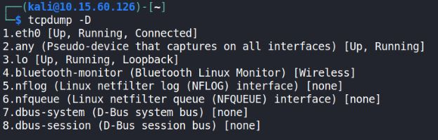
Find Your Network Interface
Use the following command to find all the available network interfaces
tcpdump -D
Your ethernet port should be eth0 (or similar) and is probably the first option
Write this down, you will need to use this network interface throughout the lab

Slide 8
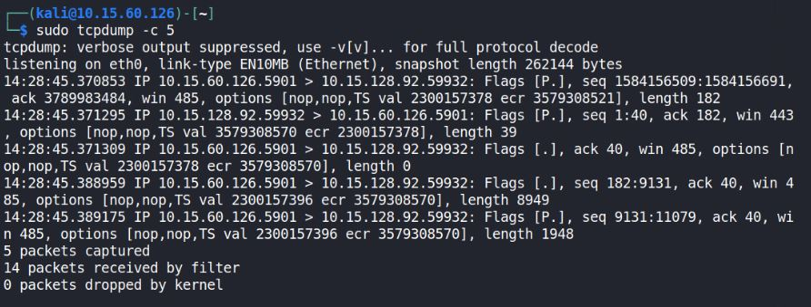
Capture Packets!
To capture packets, use the following command:
sudo tcpdump –i <Network Interface>
Here, i stands for interface
Thus, the command is run tcpdump on the interface of the network you specify
Press CTRL+C to stop capturing packets
To only capture 5 packets, use the following:
sudo tcpdump –c 5
-c stands for count
tcpdump runs for a count of 5 times

Slide 9
Contents of a Packet
Take a look at one single packet and explore what it contains
Packet number
23036 of 35439
Acknowledge packet
(It was received) [SYN-SYNACK-ACK]
Time captured
Sender Hostname
Receiver Hostname
13:38:20.769918 IP wingnut.cyber.org > nail.cyber.org : Flags [P.], seq 23036:35439, ack 1, win 252, options [nop,nop,TS val 311299592 ecr 1520106470], length 12403
Window Size
[Larger window, more throughput]
TCP options field
Packet Length

Slide 10
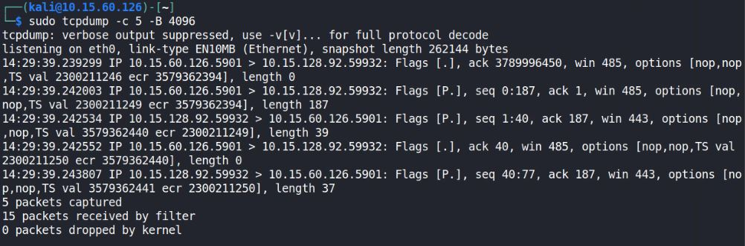
Reduce Packets Dropped
What if you want to capture more packets? (e.g. decrease the number of packets dropped)
Try the following command:
sudo tcpdump –c 5 –B 4096
-B 4096 stands for a buffer of 4096, thus reducing the number of packets dropped
How many fewer packets were dropped when using this larger buffer?
What if you go higher?

Slide 11
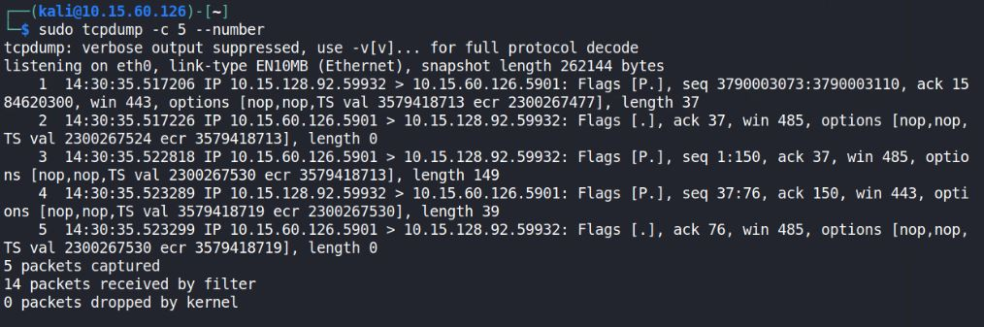
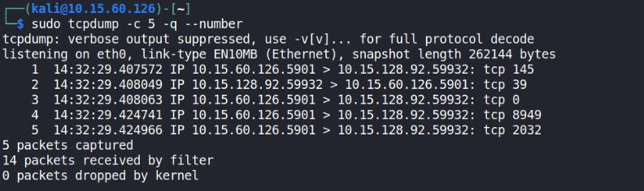
Clean-up the Output
To number the packets, use the --number option:
sudo tcpdump –c 5 --number
To simplify the output, use the -q option:
sudo tcpdump –c 5 -q --number
Here, -q stands for quiet output

Slide 12
Contents of a “Quiet” Packet
Let’s break down one of these quiet packets!
Notice how much less information is presented.
Time captured
Sender Hostname
Receiver Hostname
Packet Number
13:38:20.769918 wingnut.cyber.org > nail.cyber.org: tcp 23036
Using TCP

Slide 13
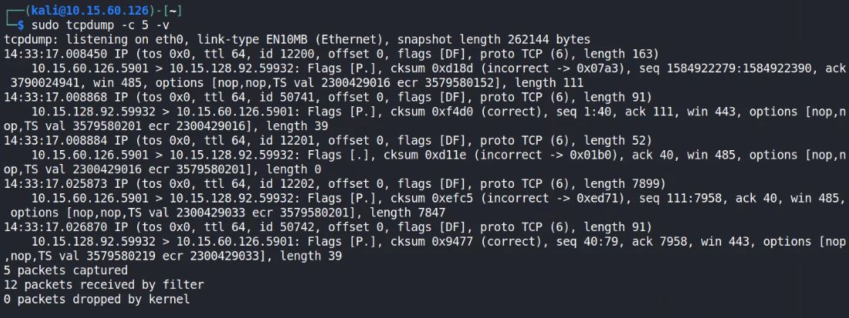
Expand the Output
To expand the output, use the -v option:
sudo tcpdump -c 5 -v
-v stands for verbose

Slide 14
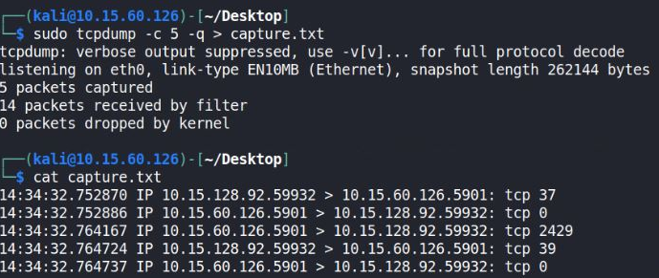
Capture as a .txt File
First, navigate to the Desktop directory using the following command:
cd Desktop
Now, capture the packets as a txt file use the > redirection tool:
sudo tcpdump -c 5 -q > capture.txt
> capture.txt is redirecting the output from the screen to a file named capture.txt
To read the file, use the following command:
cat capture.txt

